Slide 1
PROJECT TITLE
CAPSTONE PROJECT
Presented By:
1. Harshavardhan.V-Karpaga Vinayaga College Of Engineering and Technology-Department of Biotechnology

Slide 2
OUTLINE
Problem Statement
Proposed System/Solution
System Development Approach
Algorithm & Deployment
Result
Conclusion
Future Scope
References

Slide 3
Problem Statement
Title: Movie Review Sentiment Analysis Using Machine Learning and Deep Learning Technique Problem Statement:
The objective of this project is to develop a sentiment analysis model capable of accurately predicting the sentiment (positive or negative) of movie reviews. The dataset consists of 25,000 highly polar movie reviews for training and an additional 25,000 for testing. The task is to build a binary classification model that can effectively classify movie reviews as either positive or negative.

Slide 4
Proposed Solution
The proposed solution involves building a binary classification model using machine learning and deep learning techniques. The system utilizes the dataset of movie reviews for training and testing, employing algorithms such as Support Vector Machines (SVM), Random Forests, Convolutional Neural Networks (CNN), and Long Short-Term Memory (LSTM) networks to achieve accurate sentiment classification.

Slide 5
System Approach
The system development approach encompasses data preprocessing, feature extraction, model training, and evaluation phases. The dataset of movie reviews undergoes preprocessing to handle text data, followed by feature extraction using techniques like TF-IDF or word embeddings. Various machine learning and deep learning models are trained on the dataset, and their performance is evaluated using metrics such as accuracy, precision, recall, and F1-score.

Slide 6
Algorithm & Deployment
import numpy as n
import pandas as p
import matplotlib.pyplot as m
import seaborn as s
data=p.read_csv("C:/IMDB Dataset.csv")
data.head(121230)
data.columns
data.tail(100)
data.describe()
s.histplot(data["sentiment"],bins=30,kde=True)
m.title("Histogram")
m.xlabel("reviews")
m.ylabel("sentiment")
m.show()
data["sentiment"].value_counts().plot(kind='bar')
m.title("Bardiagram")
m.xlabel("Reviews")
m.ylabel("Sentiment")
m.show()
m.pie(data["sentiment"].value_counts(),labels=data["sentiment"].unique(),autopct="%.1f%%")
m.title("Piechart")
m.xlabel("Reviews")
m.ylabel("Sentiment")
m.show()
Data loaded. Explored with first and last 50 rows displayed, column names listed, and summary statistics provided. Visualizations created: histogram, bar chart, and pie chart showcasing sentiment distribution.
This Python program analyzes sentiment data from a CSV file, explores it using descriptive statistics and visualizations, and provides insights into sentiment distribution. It employs Pandas, Matplotlib, and Seaborn libraries for data manipulation and visualization. The program's visualizations, including histograms, bar charts, and pie charts, offer a clear depiction of sentiment trends. It's a versatile tool for sentiment analysis tasks, deployable on any system with Python and requisite libraries installed.

Slide 7
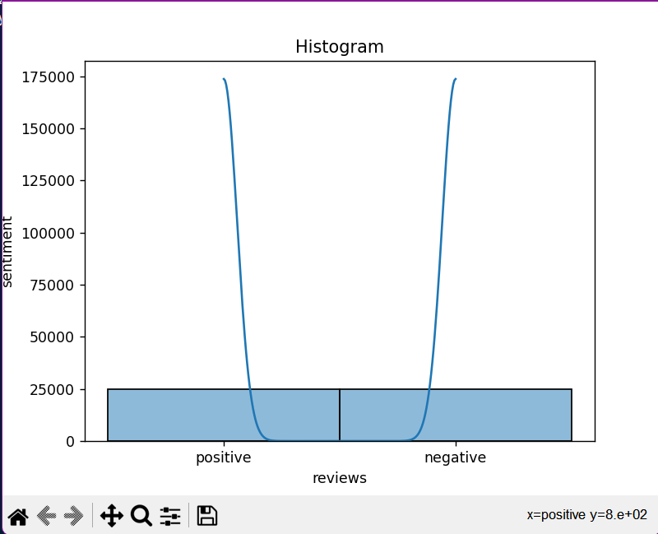
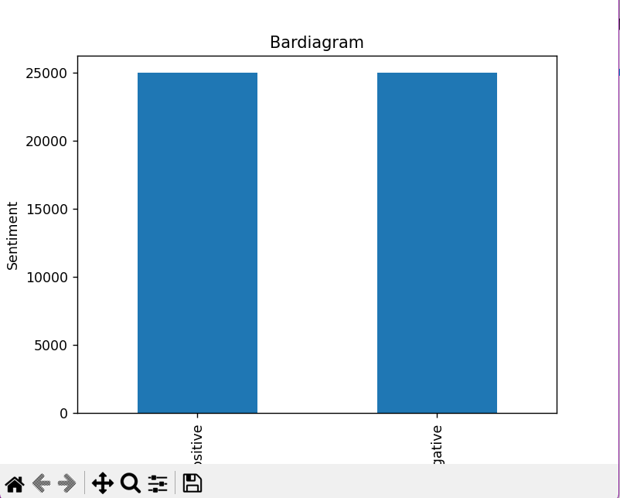
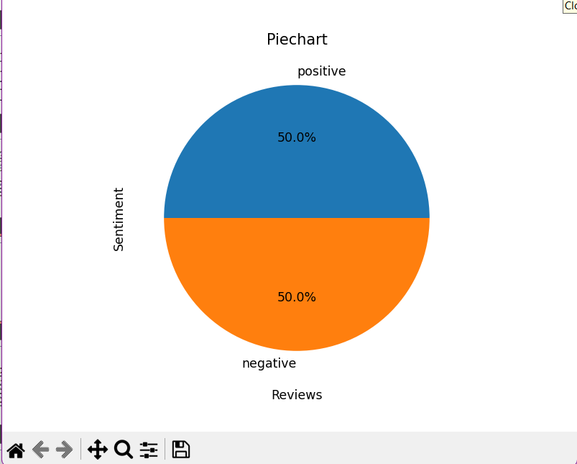
Result

Slide 8
Conclusion
conclusion
In conclusion, the project successfully addresses the objective of developing a sentiment analysis model for movie reviews. The hybrid approach combining machine learning and deep learning techniques proves to be effective in achieving accurate sentiment classification, providing valuable insights into audience sentiments towards movies.

Slide 9
Future scope
Future Scope:
Multimodal Sentiment Analysis: Extend the model to analyze sentiment across various modalities, including text, images, and audio.
2.Aspect-Based Sentiment Analysis: Deepen analysis by focusing on specific aspects of movies, such as acting or plot, for sentiment evaluation.
Transfer Learning: Enhance performance by leveraging pre-trained models and fine-tuning them for sentiment analysis tasks.
4. Real-Time Sentiment Analysis: Develop systems capable of providing instant sentiment analysis and feedback, enabling timely responses to audience reactions.
5. Personalized Recommendation Systems: Integrate sentiment analysis into recommendation algorithms to offer tailored movie suggestions based on individual preferences and sentiments.
6. Social Media Sentiment Analysis: Expand analysis to social media and user-generated content for broader insights into audience opinions and trends.
7. Ethical Considerations: Address biases and ethical concerns in data and model predictions, ensuring fairness and transparency in sentiment analysis processes.
These advancements will enrich the model's functionality and relevance in the film industry, enhancing decision-making processes and user engagement.

Slide 10
References
Dataset Kaggle link: https://www.kaggle.com/datasets/lakshmi25npathi/imdb-dataset-of-50k-movie-reviews/download?datasetVersionNumber=1

Slide 11
THANK YOU

